Slide 1
NewsChain News Co-authoring Platform Powered by Ethereum
PAN Zhiqi 14252023

Slide 2
Content
Introduction
Background of Ethereum and journalism
Objective
Technology Stack Overview
Platform Core Features and Implementations
System Internals
Contract design and interaction
Exploring the source code
Live Demo
Reflection and Discussion

Slide 3
Background
Blockchain is a new blooming technology in recent years
To ensure data integrity and transparency, each block is chained to the previous one via a cryptographic hash and a consensus algorithm is run in the distributed network.
Consensus algorithms (e.g. Proof of Work)
Ethereum, an open decentralized software platform running on blockchain, is one of the most popular blockchain applications nowadays.

Slide 4
Background
On the journalism side, in current world, information fed to the users is getting more and more biased due to an advertisement-driven nature of social media and news platforms.
Both news on new and traditional media platforms are centralized and fully controlled by one or more authorities subject to censorship and selective bias. From agenda setting to priming, authorities do not give chances for the public to voice for themselves.
I believe in citizen journalism and the wisdom of crowds

Slide 5
Objective
Applies smart contracts in Ethereum to fulfill innovative features that traditional journalism does not have
Break through in journalism industry by empowering the general public with a news co-authoring platform
break down the centralized authorities, and build up a decentralized platform
Untamperrable, transparent, traceable

Slide 6
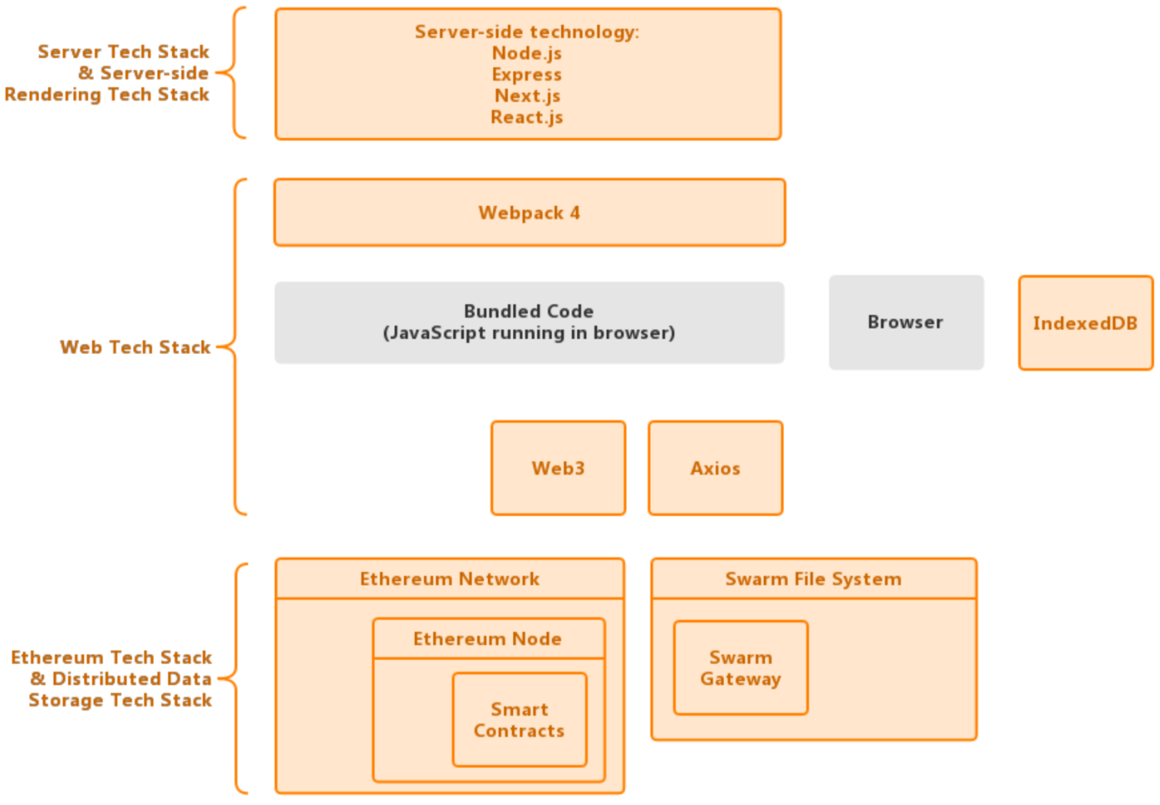
Tech Stack Overview

Slide 7
Platform Core Features and Implementations
Article Creation and Persistence
Article Modification and History Tracking
Article Citation
Article Rewarding by Ether
NewsChain Token and Article Rewarding by ERC20 Tokens
Citation Auto Reward as NCT Token Initial Coin Offering (ICO)
Citation Relationship Visualization

Slide 8
1. Article Creation and Persistence
Article publishing is a transaction done by the interaction with a smart contract named Article Factory, which in turn instantiates an Article contract and creates one in the Ethereum network.
All metadata about the article itself is stored in storage variables in the Article contract, while the article content is stored in Swarm instead.

Slide 9
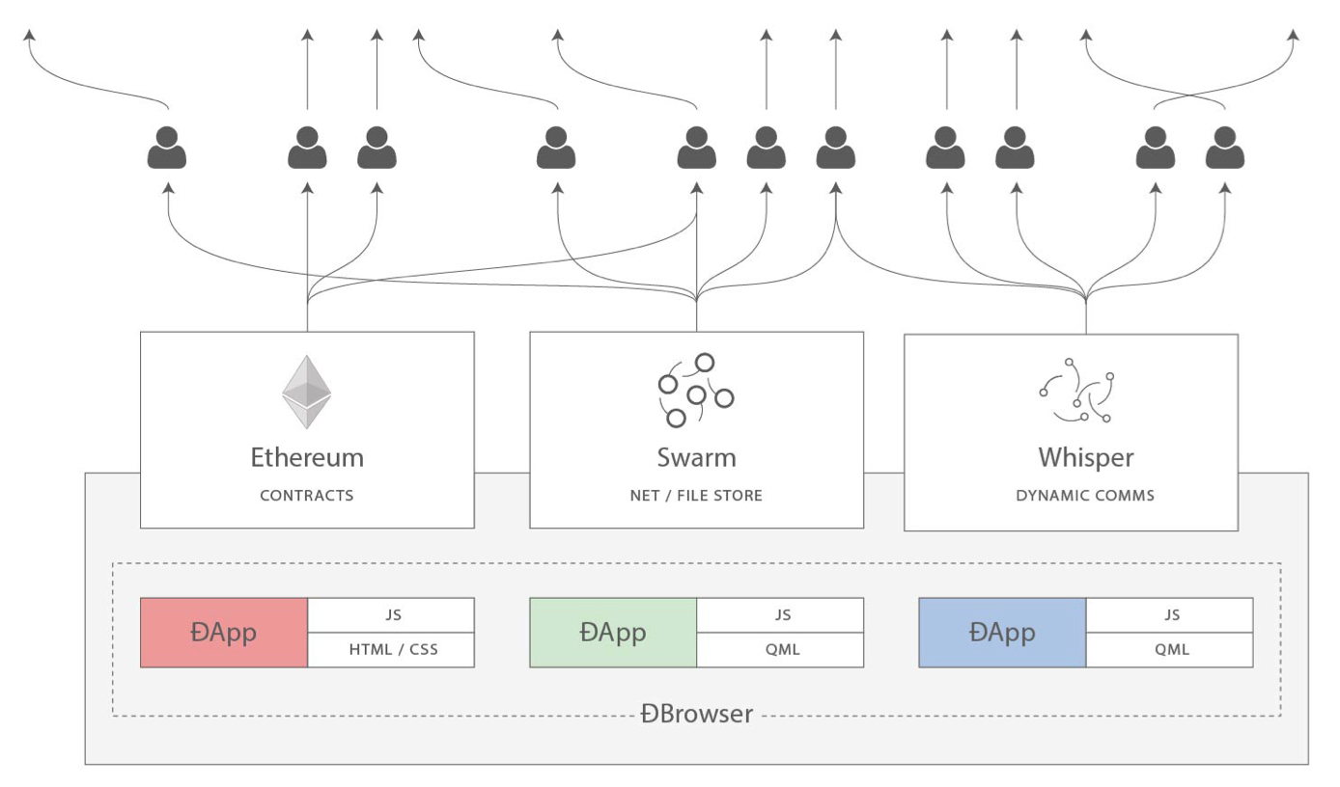
1. Article Creation and Persistence - Ethereum and and Swarm

Slide 10
1. Article Creation and Persistence - Ethereum and Swarm
Ethereum itself focuses on smart contracts while storing massive data in it would be ridiculously expensive (in terms of gas), while Swarm aims to solve such issue by providing a distributed peer-to-peer network to persistently to store all the data objects.
In Swarm, each data object (e.g. JSON data, image or document) is referenced by a unique 64-digit hex hash value (1 to 1 relationship), and by cryptographical hashing the integrity of the file content is guaranteed.

Slide 11
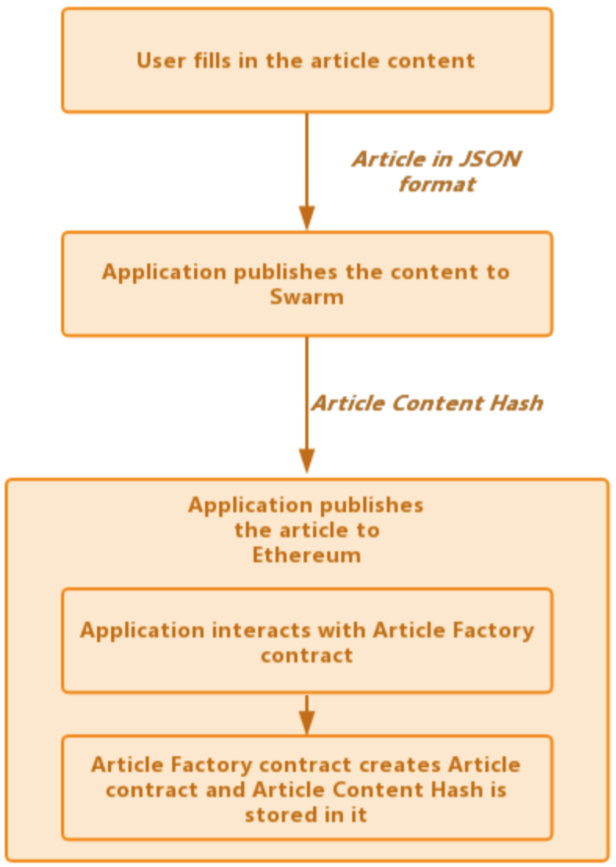
1. Article Creation and Persistence - Ethereum and Swarm
Steps of publishing
a new article

Slide 12
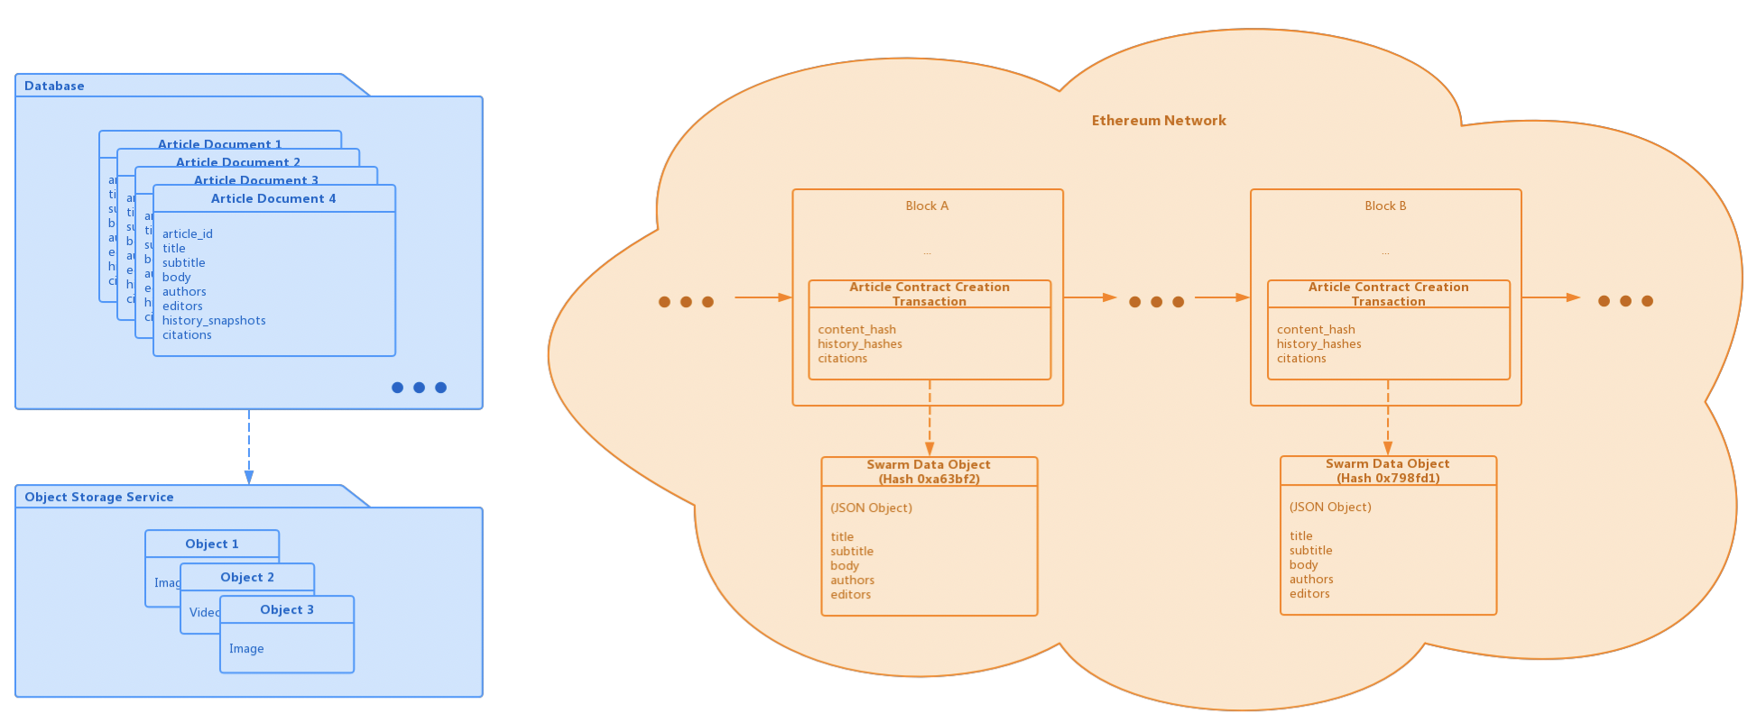
1. Article Creation and Persistence - Why and how does this way of article creation and persistence prevail the traditional way?
Transparency, decentralization, traceability
untamperrability and consistency

Slide 13
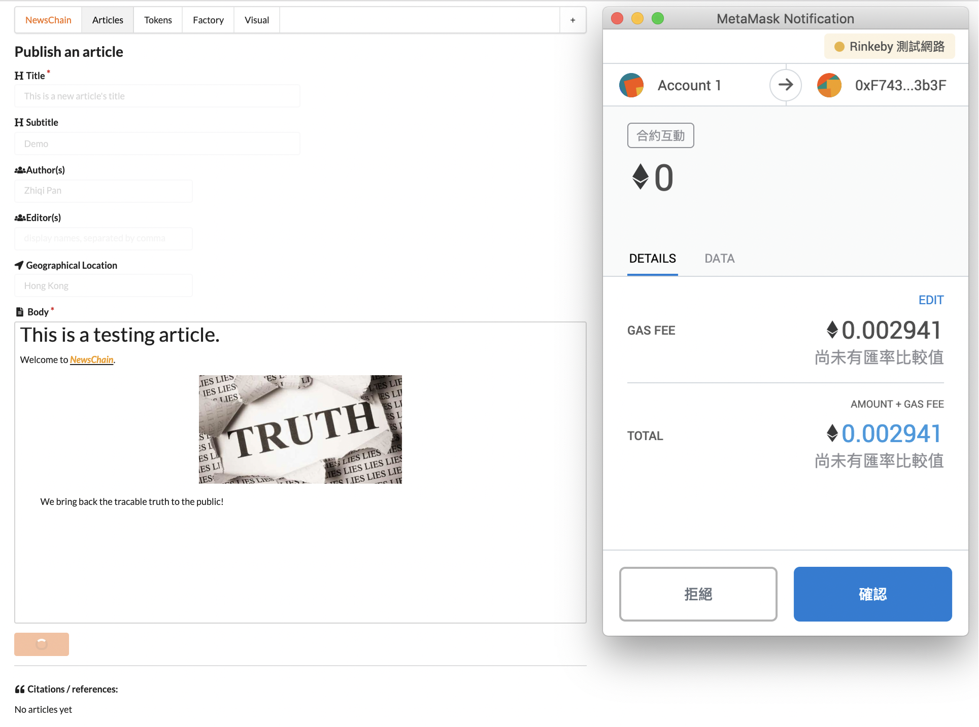
1. Article Creation and Persistence - Interaction via MetaMask

Slide 14
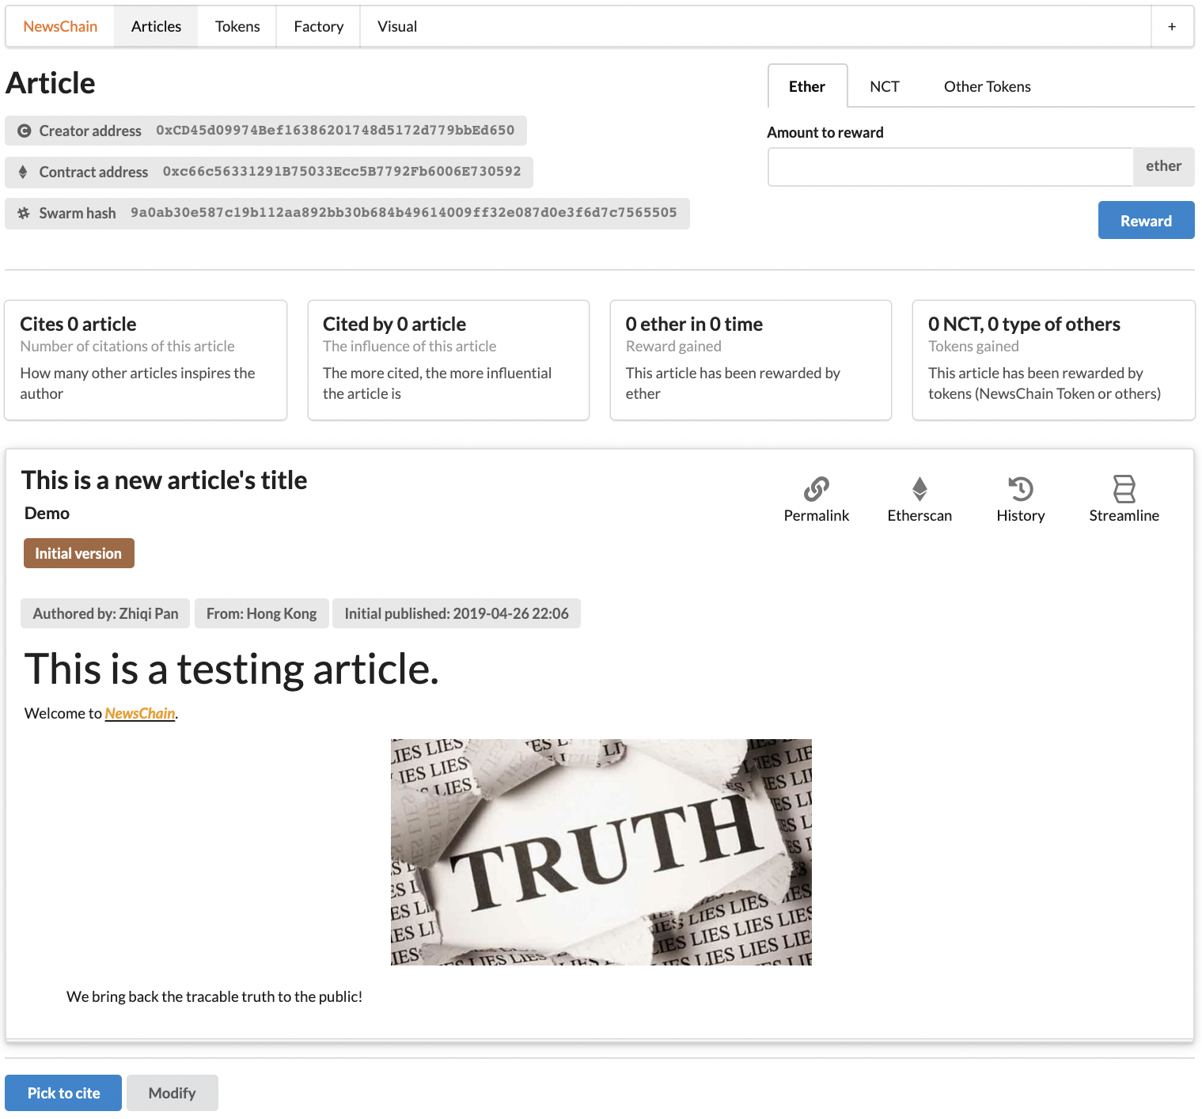
1. Article Creation and Persistence - Interaction via MetaMask

Slide 15
2. Article Modification and History Tracking
data on Ethereum network is not changeable, while this does not mean that our published articles cannot be modified in application level
keep track of article versions (a hash value pointer) in Article contract, and use Swarm to persistently store multiple versions of article content
if we want to modify the article content, we only have to alter such pointer and keep the historical hashes stored in the contract.
Transparent transaction for modification in articles

Slide 16
2. Article Modification and History Tracking - Authentication
Only the article creator (the one uses Article Factory contract to create the article) can perform modification
Even though it’s the creator, his/her changes are recorded in the Article contract
We prevent articles from being maliciously tampered

Slide 17
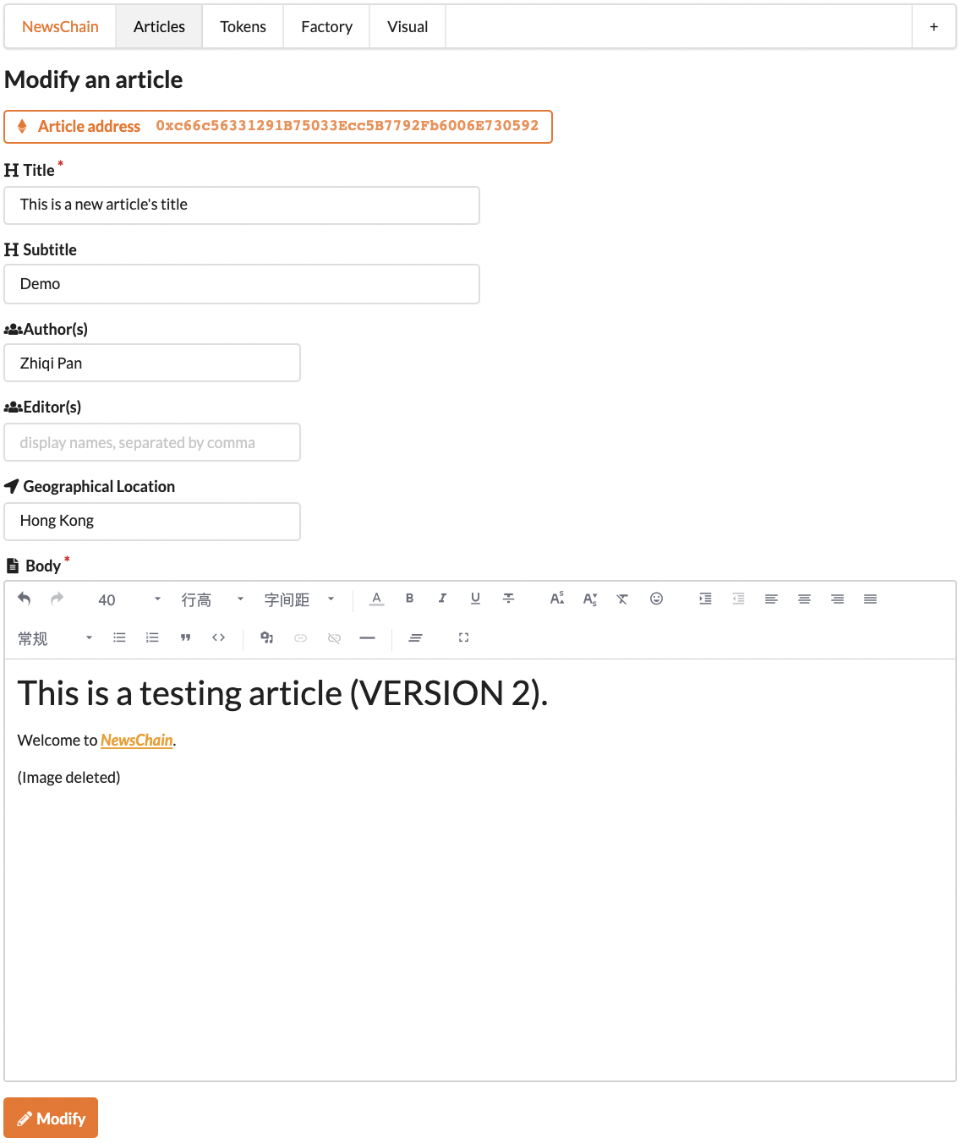
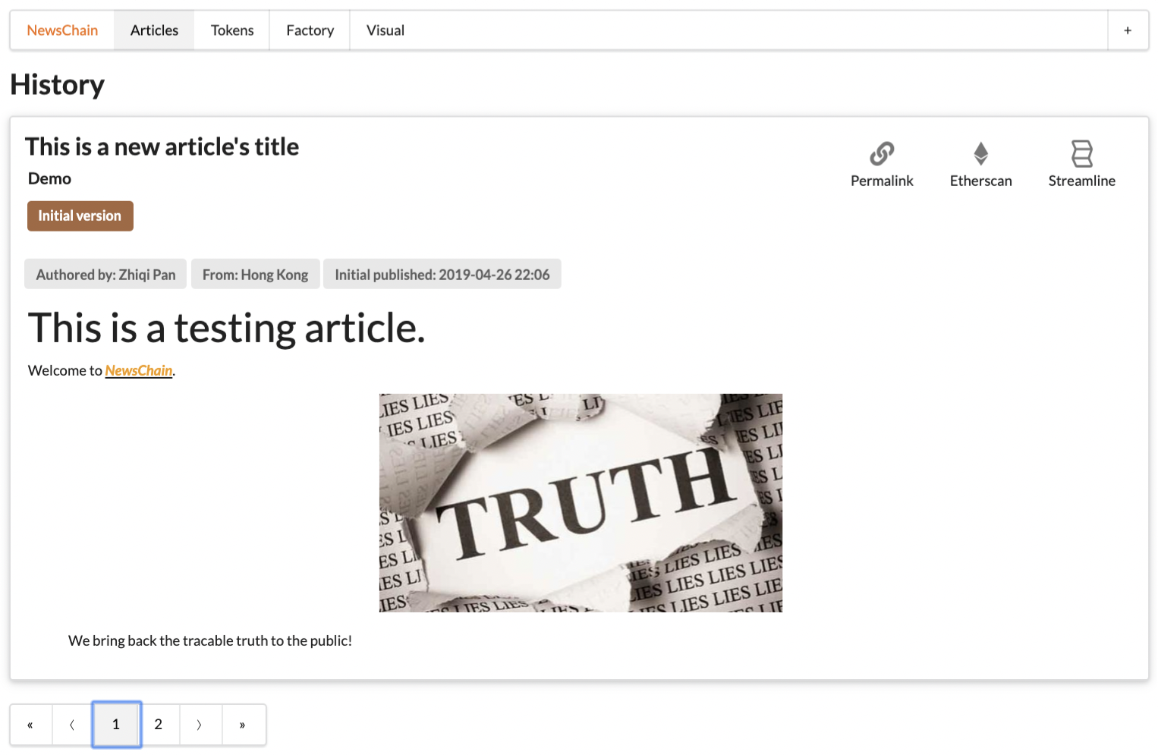
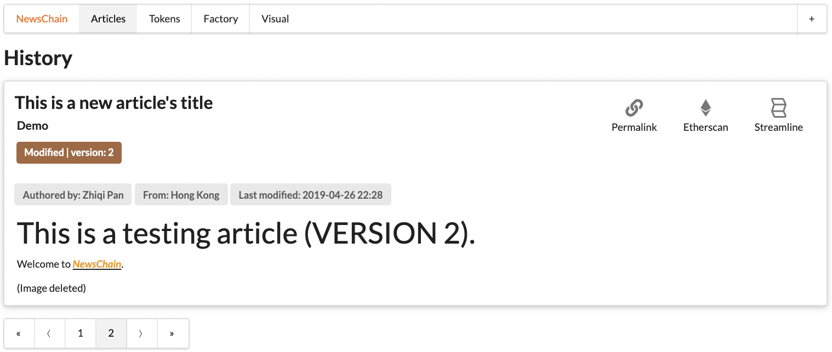
2. Article Modification and History Tracking - Interfaces of Modifying an Article

Slide 18

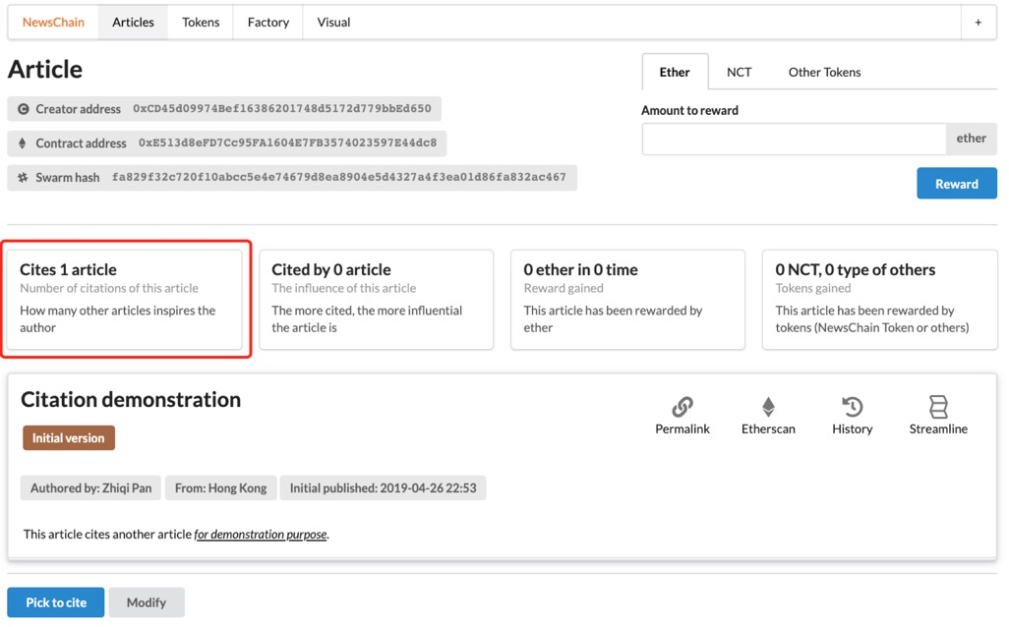
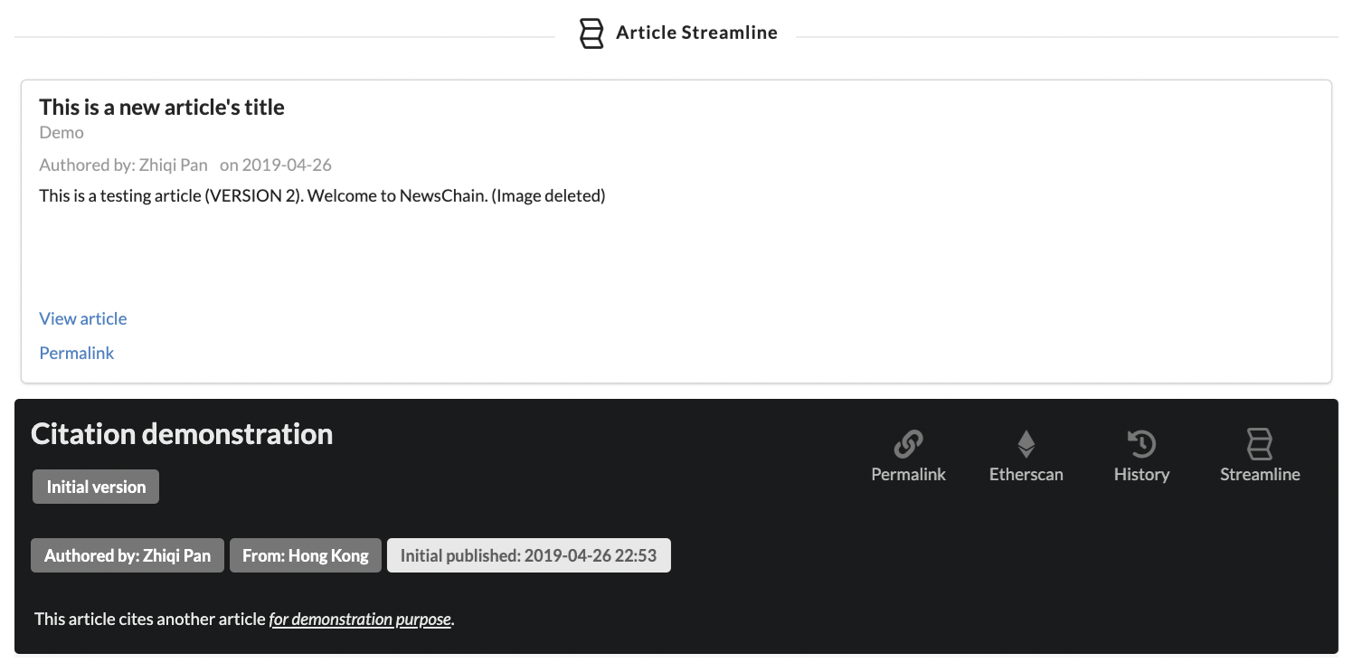
3. Article Citation
Bi-directional tracking of citation relationship is implemented
Can be considered as a bi-directional linked-list
Pick an article you want to cite before publishing a new article

Slide 19
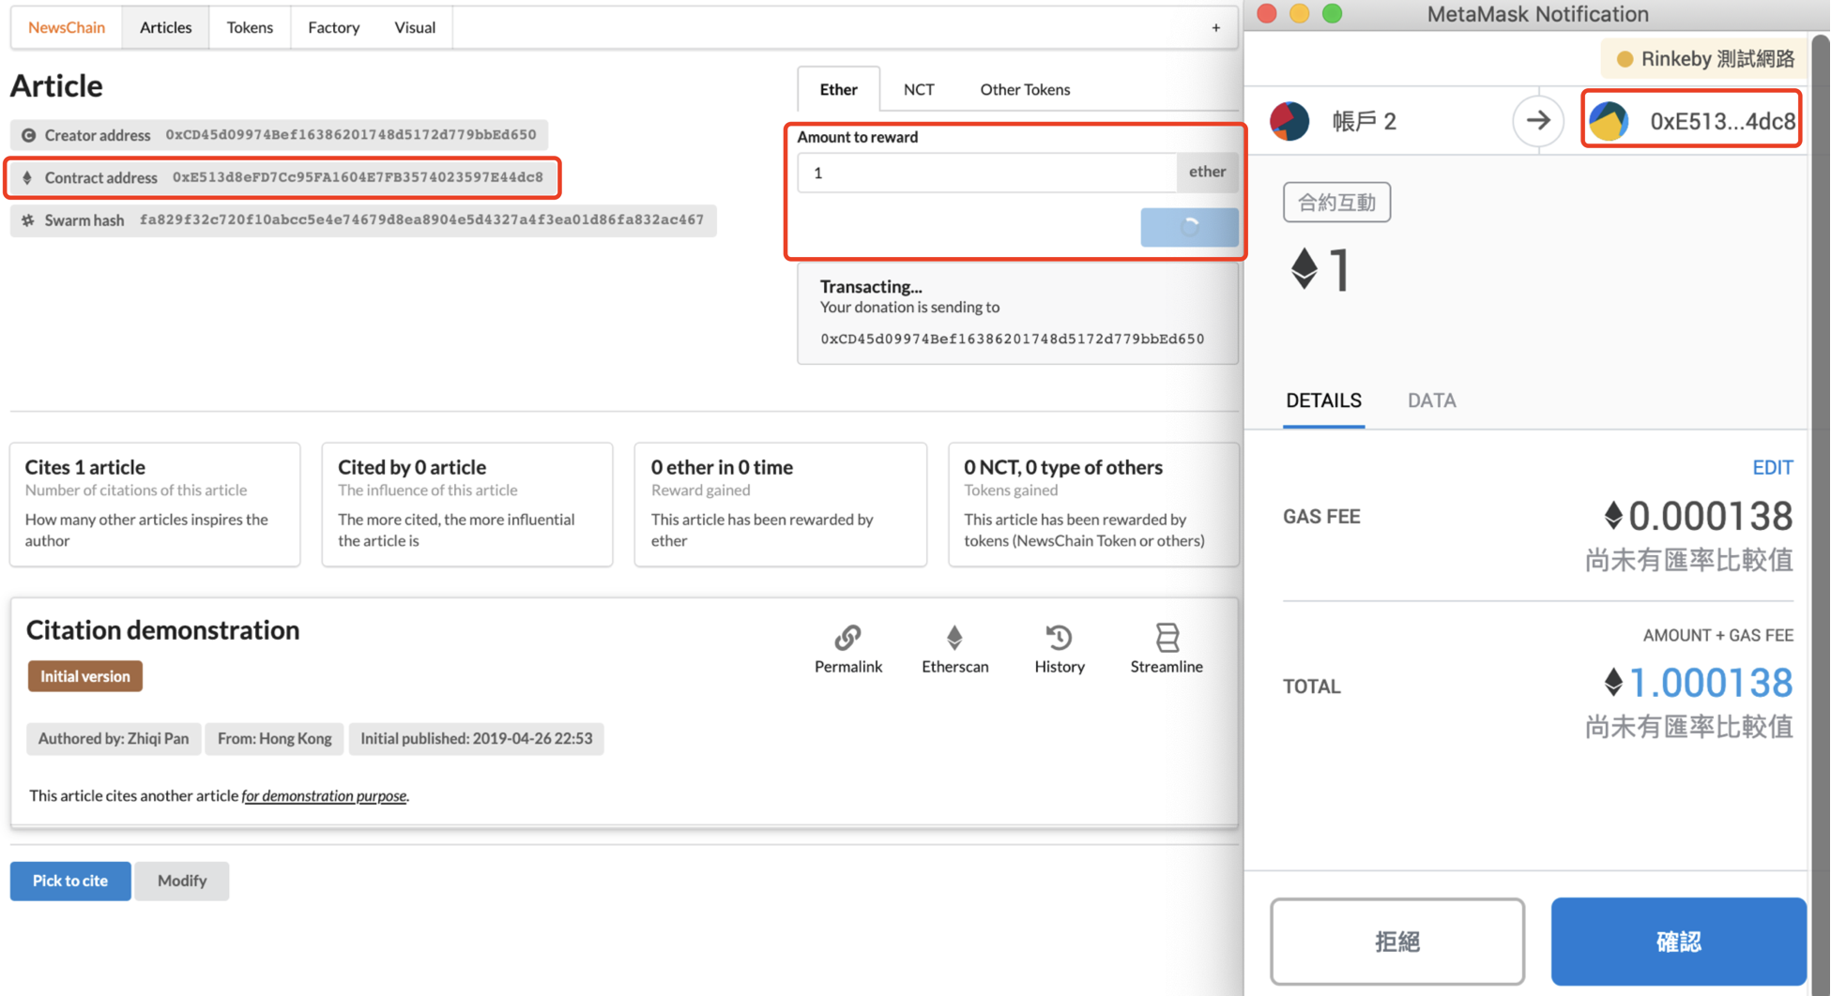
4. Article Rewarding by Ether

Slide 20
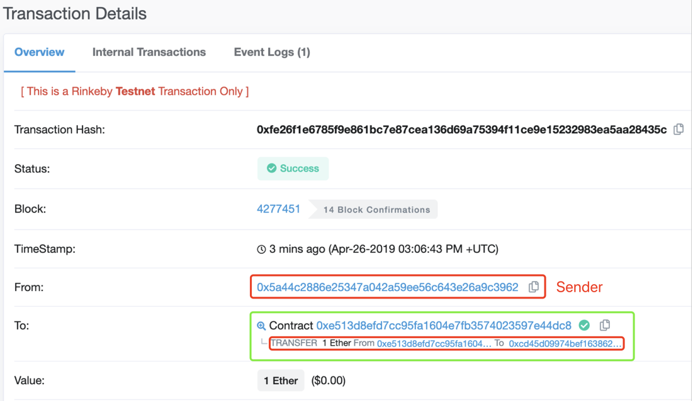
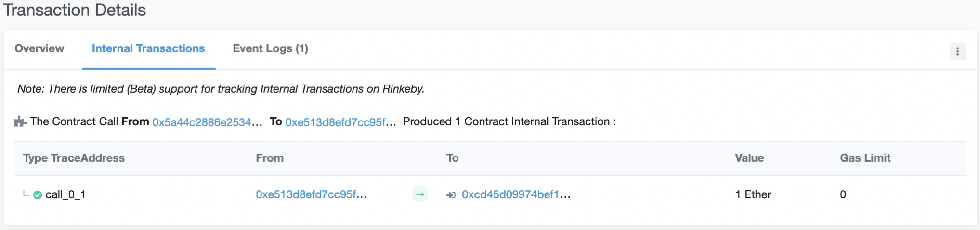
4. Article Rewarding by Ether - Internal contract transaction sending ether to the reward recipient

Slide 21
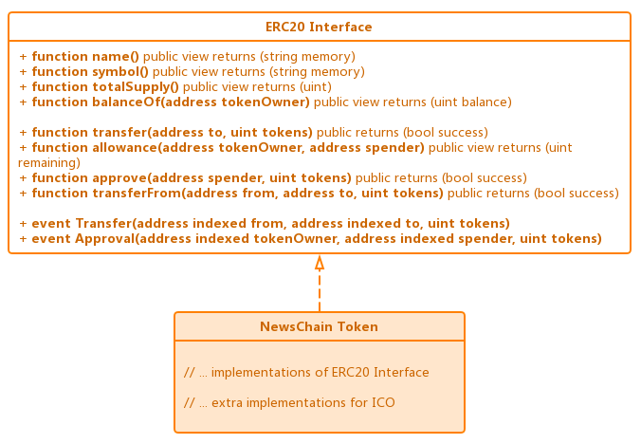
5. NewsChain Token & Article Rewarding by ERC20 Tokens
NewsChain Token implements ERC20 interface
it totally complies to the specification, in terms of basic features for transaction and advanced features for trading and ICO.

Slide 22
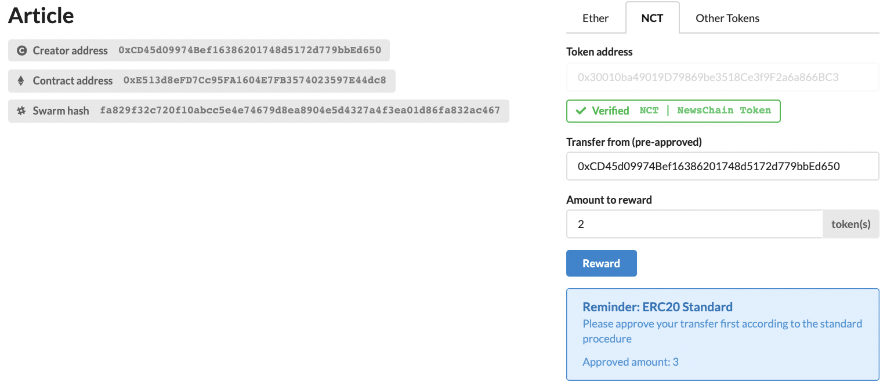
5. NewsChain Token & Article Rewarding by ERC20 Tokens

Slide 23
5. NewsChain Token & Article Rewarding by ERC20 Tokens - Approval Before Rewarding
However, rewarding is not always this simple by design, as stated in the ERC20 standard, tokens can only be sent to the recipient with an amount under the pre-approved amount.
This specification is necessary for token trading and exchanging for goods in the market, and NewsChain Token contract implements accordingly.

Slide 24
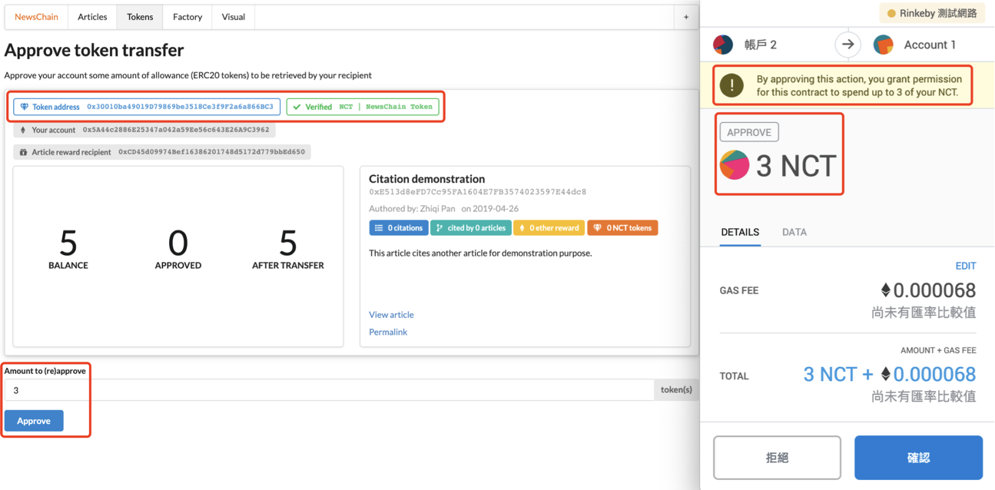
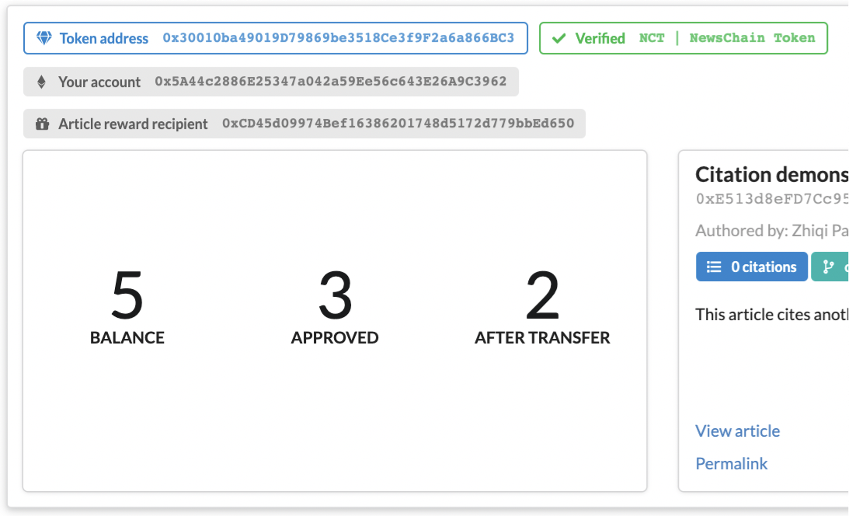
5. NewsChain Token & Article Rewarding by ERC20 Tokens - Approval Before Rewarding
*MetaMask recognizes this token because it complies to ERC20 standard

Slide 25
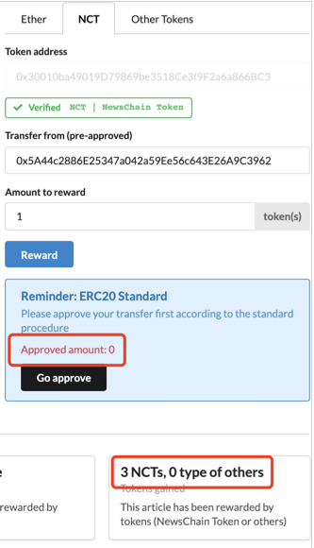
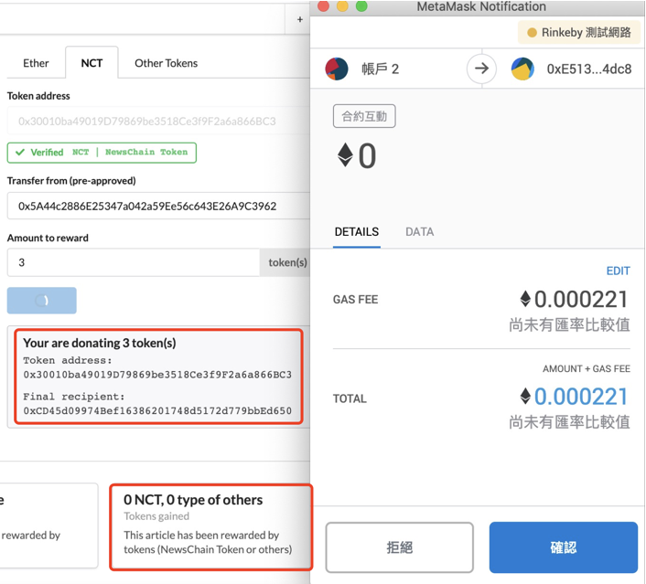
5. NewsChain Token & Article Rewarding by ERC20 Tokens - Send Rewarding Token after Approval
*MetaMask recognizes this token because it complies to ERC20 standard

Slide 26
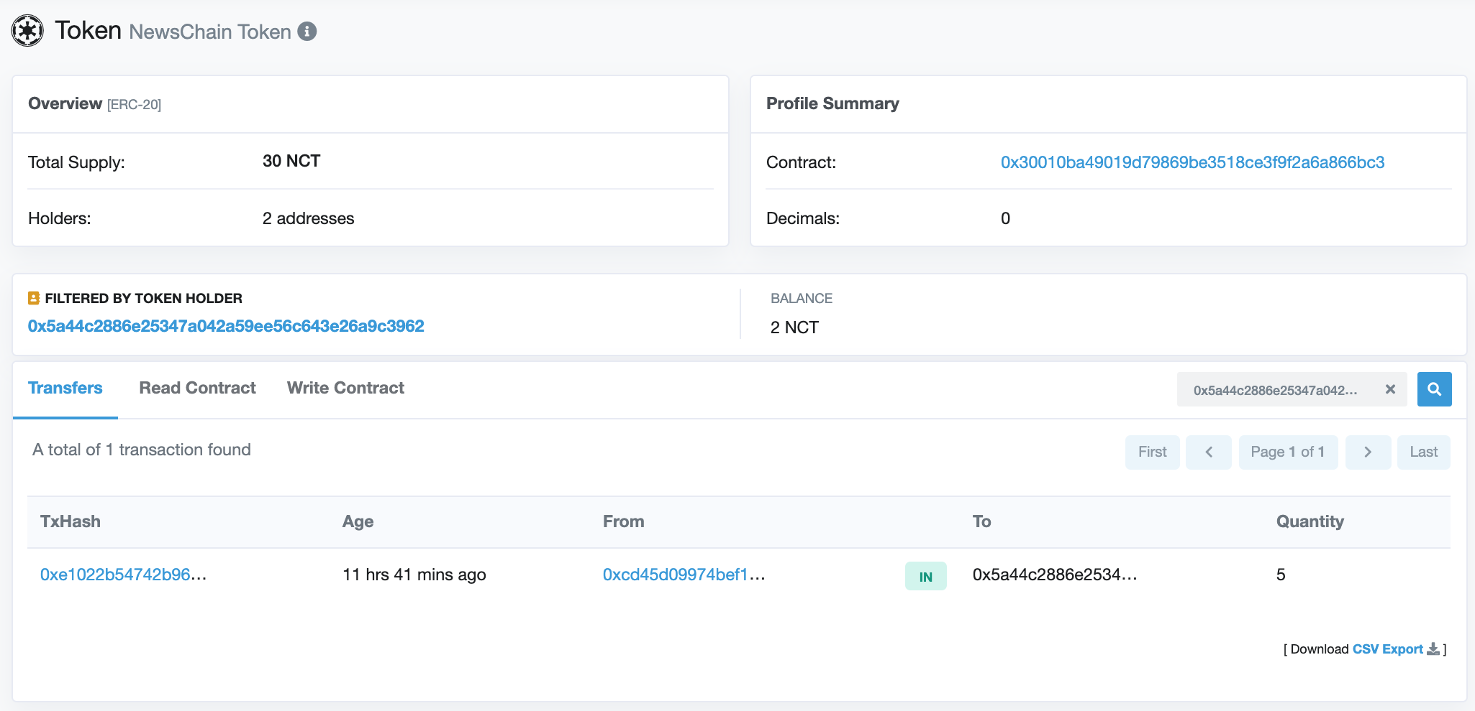
5. NewsChain Token & Article Rewarding by ERC20 Tokens - Trackable in the Public (transparency)
https://rinkeby.etherscan.io/token/0x30010ba49019d79869be3518ce3f9f2a6a866bc3?a=0x5a44c2886e25347a042a59ee56c643e26a9c3962
Notes:
https://rinkeby.etherscan.io/token/0x30010ba49019d79869be3518ce3f9f2a6a866bc3?a=0x5a44c2886e25347a042a59ee56c643e26a9c3962

Slide 27
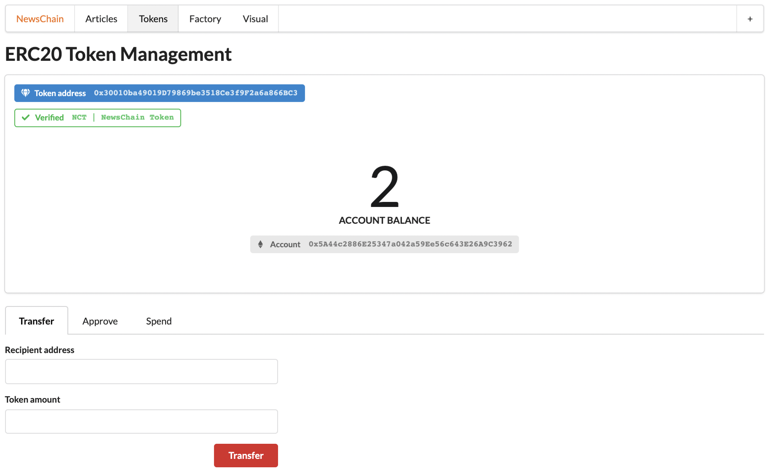
5. NewsChain Token & Article Rewarding by ERC20 Tokens - Account Management and Checking Balance

Slide 28
6. Citation Auto Reward as ICO - Intro to ICO and its Standard Procedure
For all the ERC20 tokens, they have to deal with Initial Coin Offering (ICO) procedure for one or multiple times, and this holds true too for our NewsChain Token (a.k.a. NCT).
Normally ICO are done by selling some number of tokens at a soft cap at some price of ether, our platform invents a new mechanism, citation auto reward, to offers our initial coins (tokens).
Traditional ICO is transparently controlled by the related token ICO contract, while the mechanism of NewsChain gives the power to the system manager (i.e. the creator of the Article Factory contract) to control the process of ICO.

Slide 29
6. Citation Auto Reward as ICO - Invention of Citation Auto Reward as ICO
Citation auto reward is a smart contract behavior that when an article is first time cited by a number of other articles, it receives an amount of NCT automatically issued by the NcToken contract as reward.

Slide 30
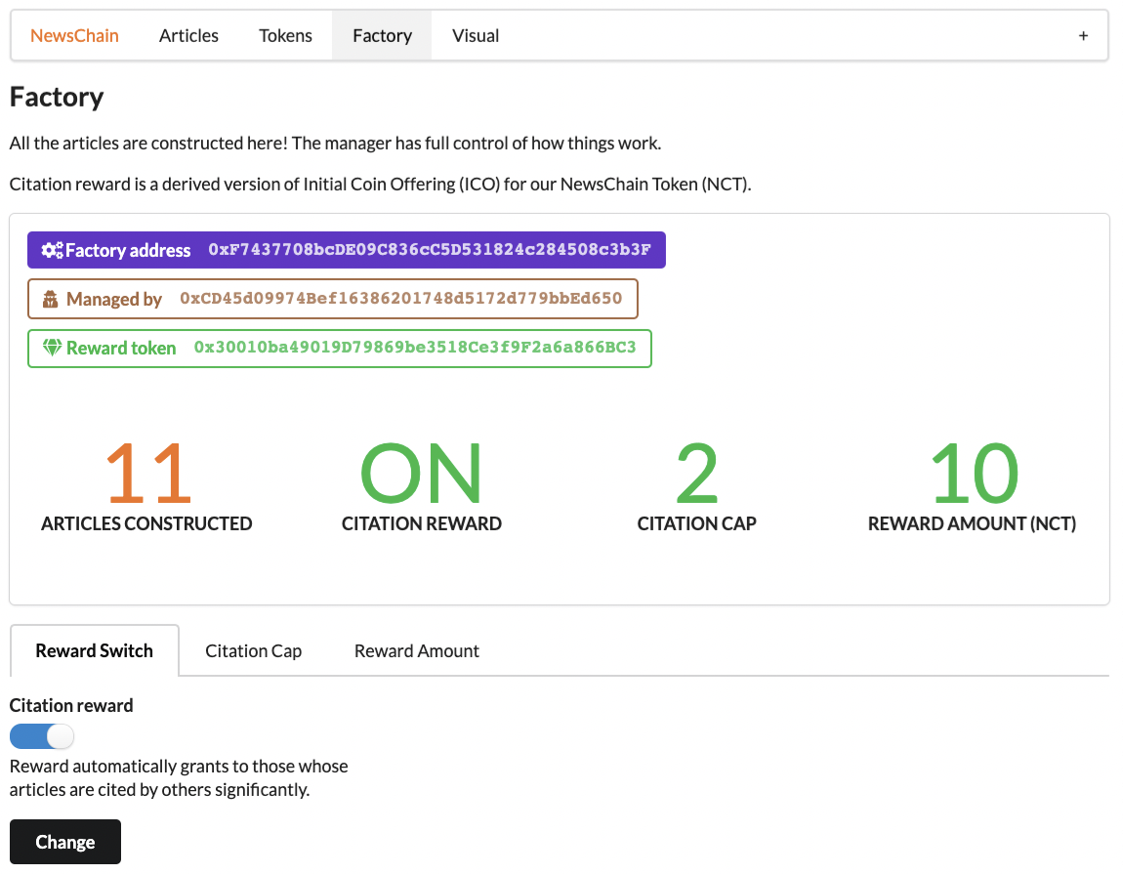
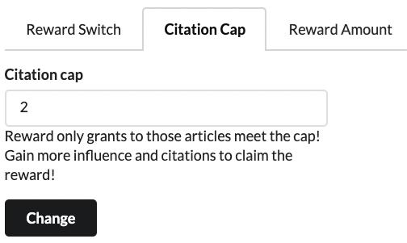
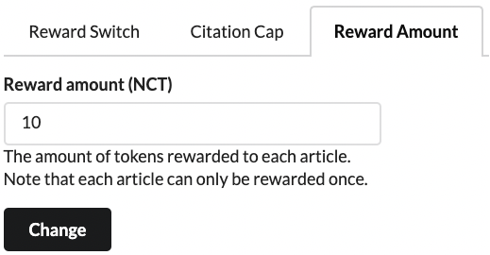
6. Citation Auto Reward as ICO - Control Panel

Slide 31
6. Citation Auto Reward as ICO - ICO Parameters
Citation Cap
Reward Amount
Reward Switch
Citation Cap: the number of citations an article should gain before getting offered NCT tokens
Reward Amount: the amount of NCT tokens rewarded
Reward Switch: the ICO is only effective when the switch is on
Notes:
Note: similar to the fact that there’s a limited coin offering period in traditional ICO process, NCT’s ICO can be turned on and off by the manager.

Slide 32
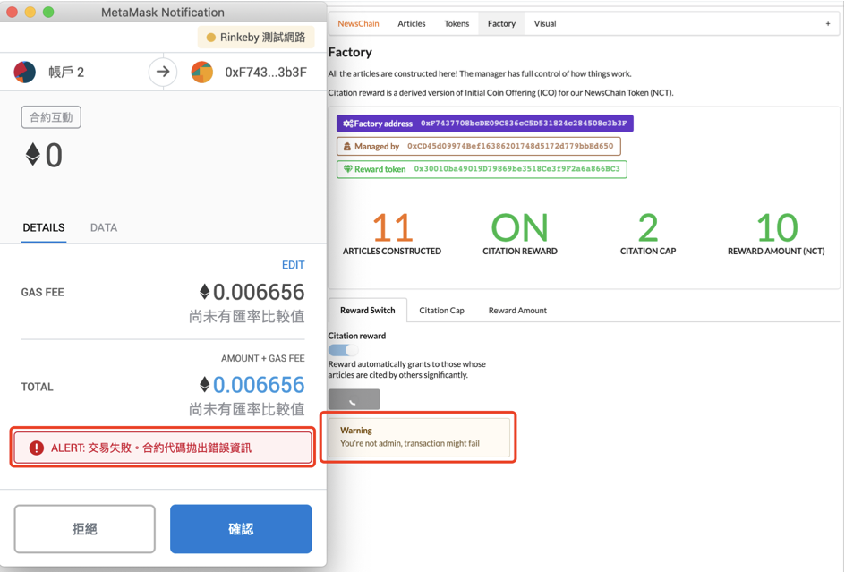
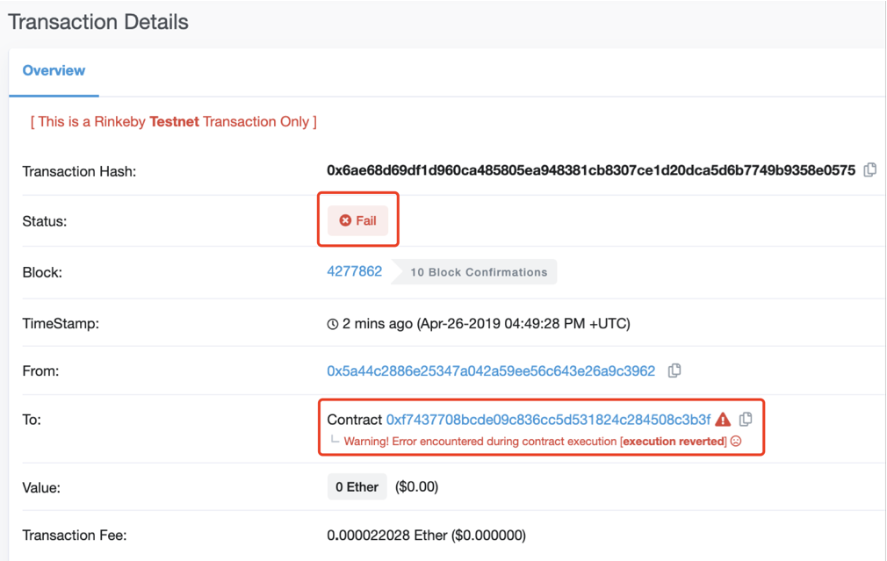
6. Citation Auto Reward as ICO - Authenticity Control
Non-manager account

Slide 33
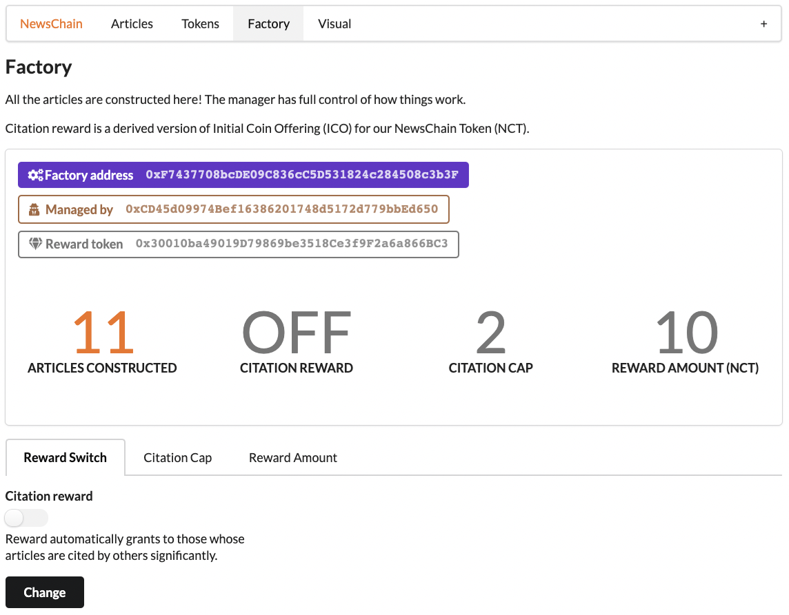
6. Citation Auto Reward as ICO - Authenticity Control
Manager account turning Citation Auto Reward (ICO) off

Slide 34
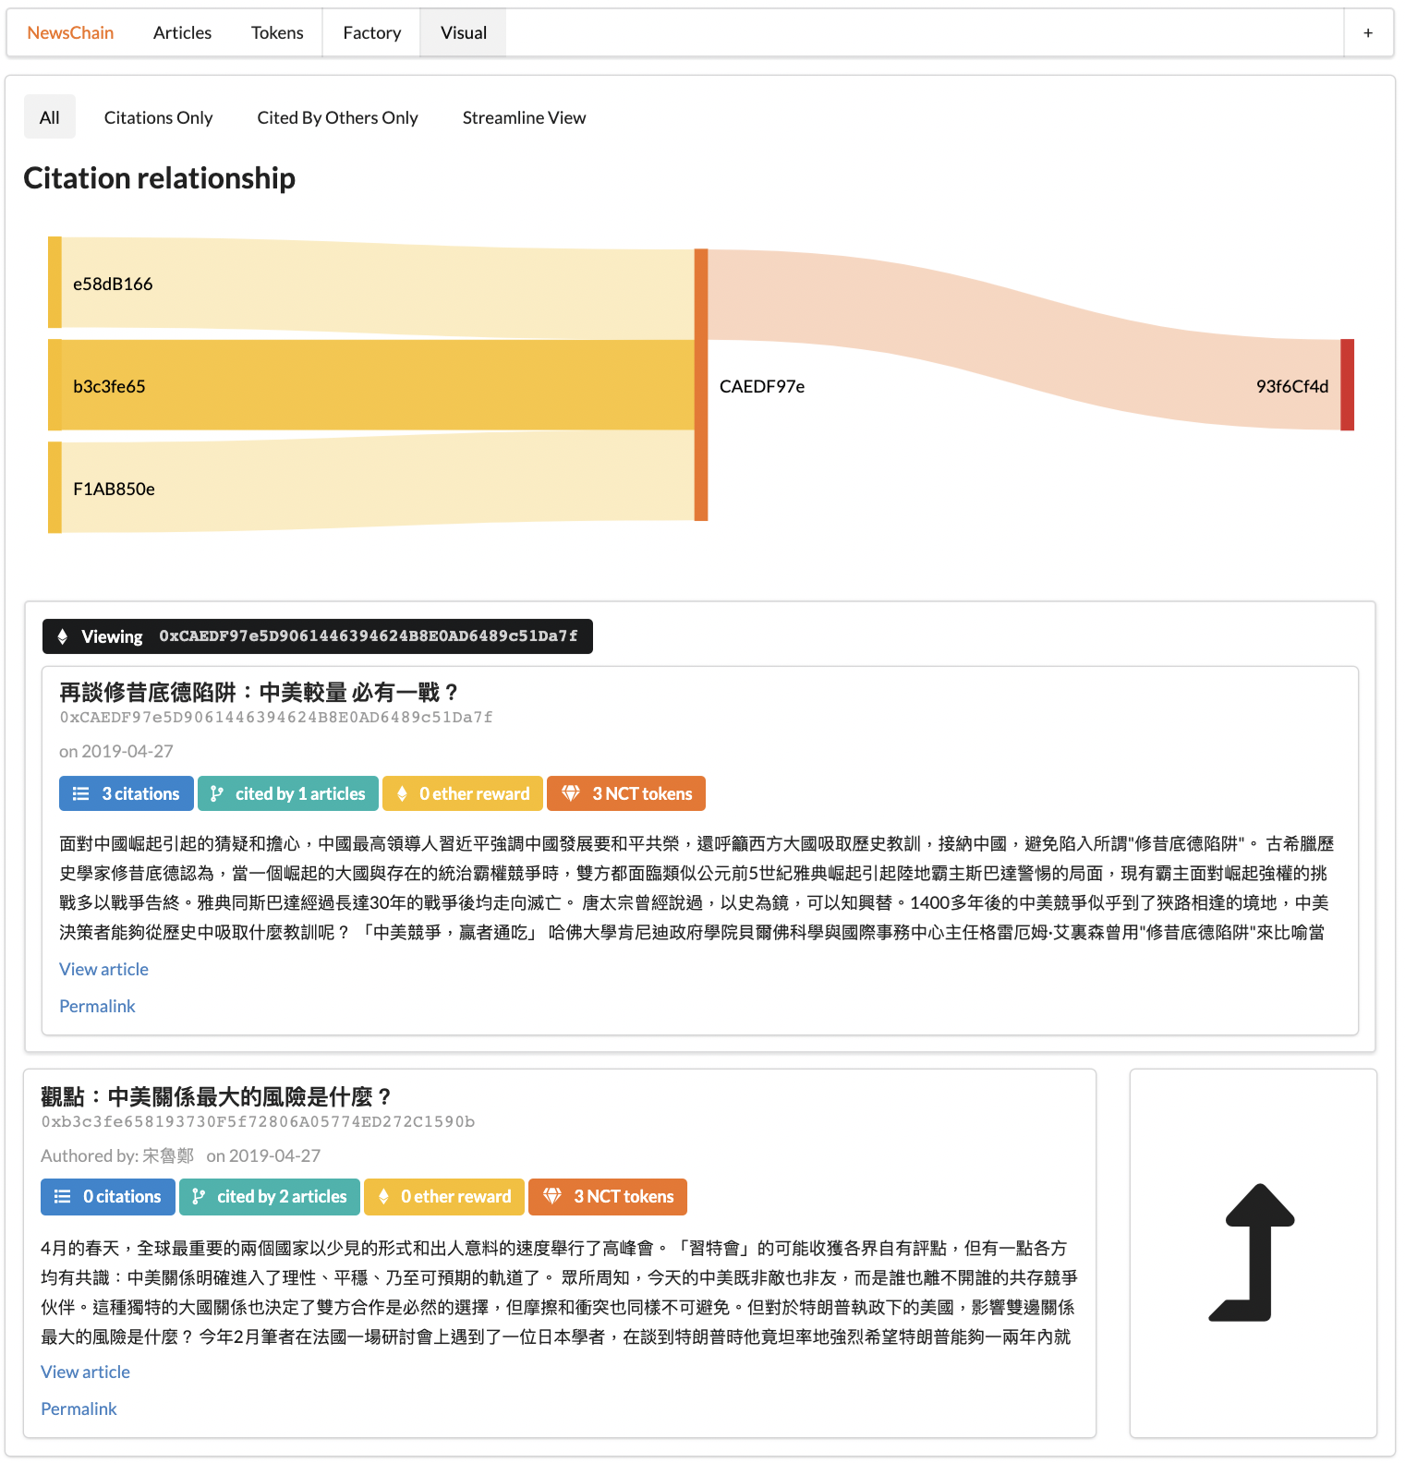
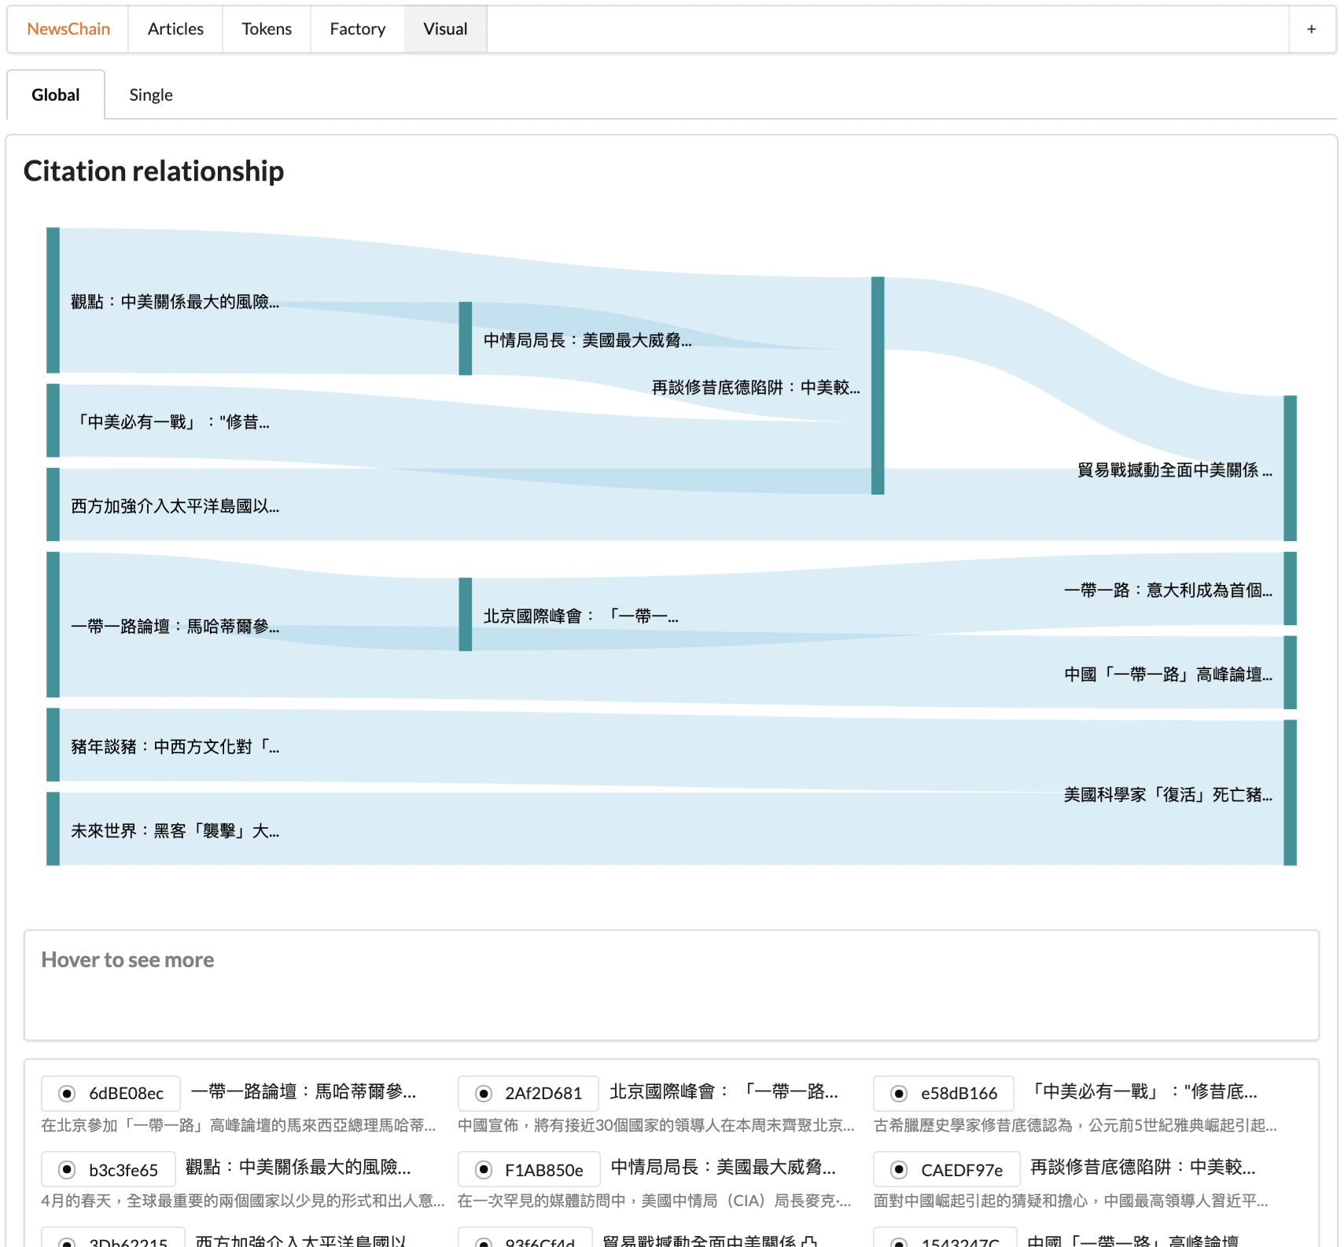
7. Citation Relationship Visualization

Slide 35
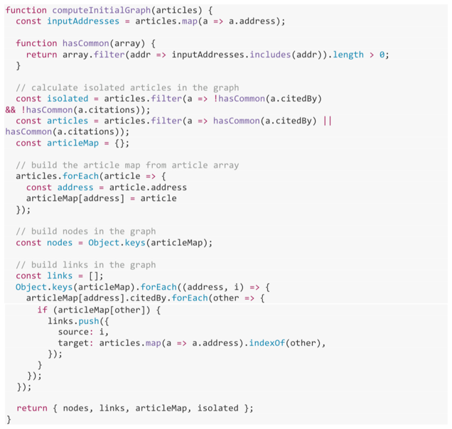
7. Citation Relationship Visualization - Data processing
A brief view at the initial graph construction algorithm for data preprocessing
Before visualizing, we apply graph algorithms to model the relationship. Such model helps us better generate and remove linkage between particular articles (nodes).
For example, once an article is deselected from the list, several other articles related to it should be removed too if those articles become isolated in the graph, and vice versa.

Slide 36
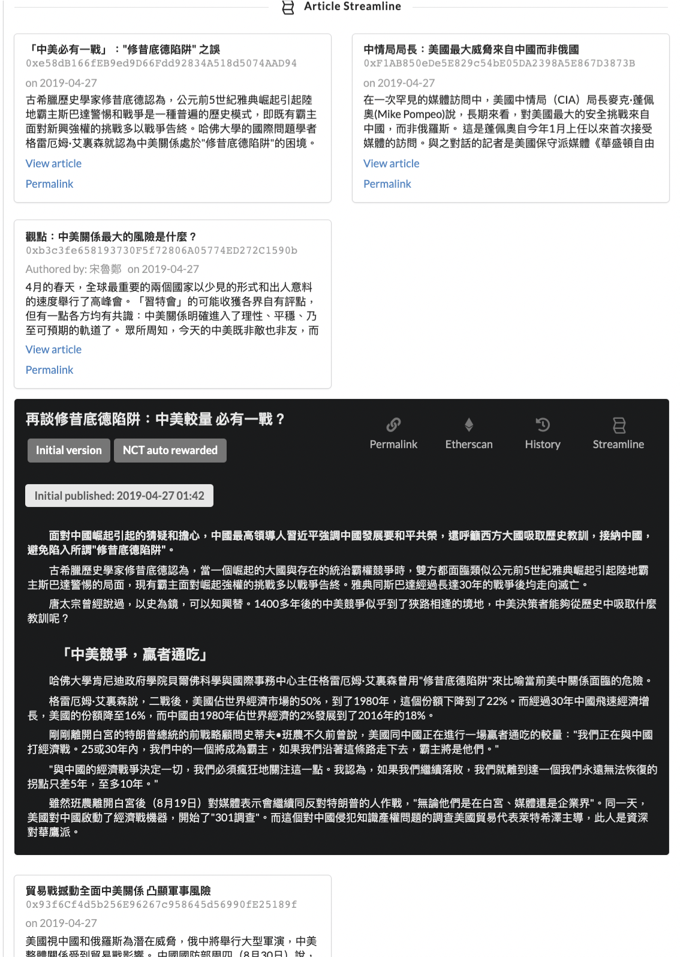
7. Citation Relationship Visualization - Streamline view of an article
This article cites / references three other articles
There’s one more article derives from the article

Slide 37
Frontend Development
Next.js Server-side Rendering and Routing of React
Reduce the number of client requests to our server
Less loading on the server and better performance on clients
State sharing in React Component - State synchronization
Redux & React Context
IndexedDB Cache - browser-side caching technology
Data Visualization
React-vis library
Data preprocessing, data real-time updating, and graph algorithm
Cache and lazy loading
Client-side searching (support keywords/key phases and logical search)
Markdown language support
regex and parsing between HTML and plaintext)

Slide 38
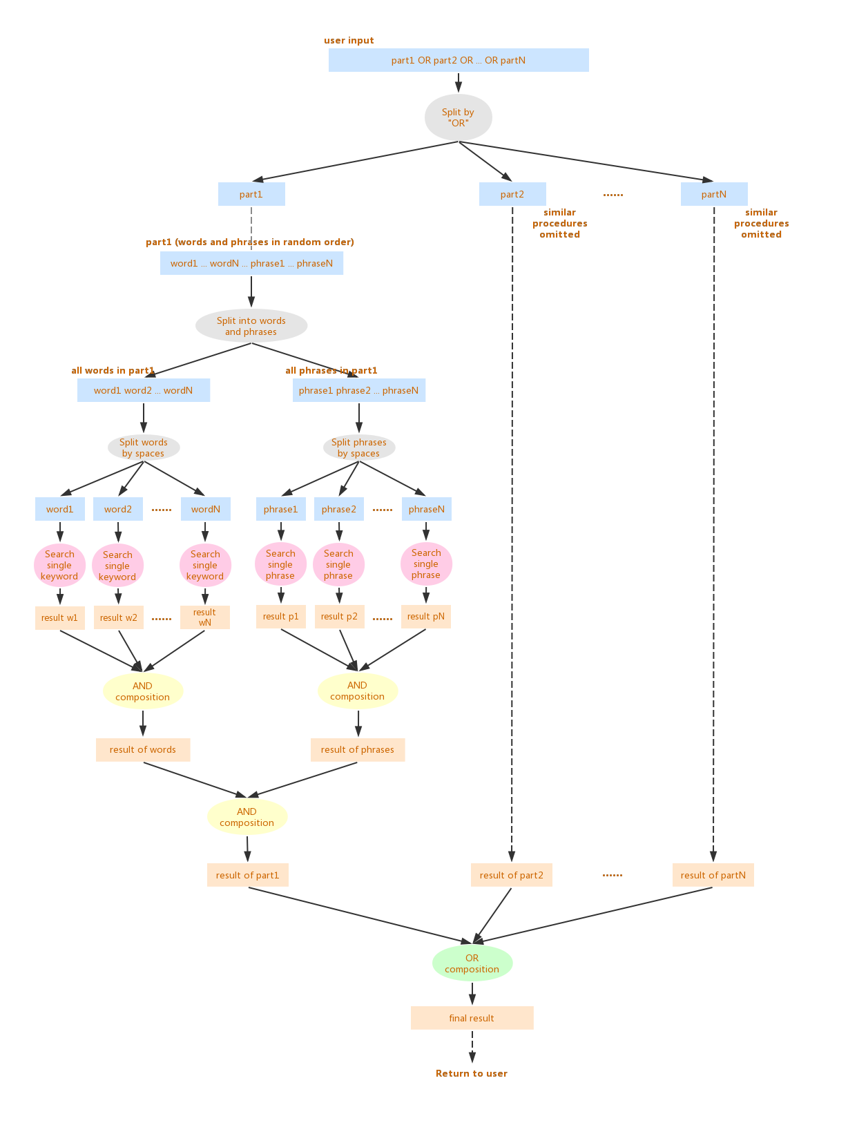
Frontend Development - Search engine
Keyword support
Key phases support
Logical keyword/key phases composition support (OR by default)
Timestamp search support
Address search support

Slide 39
System Internals
Contract Design Interaction
Contract Compilation and Deployment
Compile: Solc library with custom configuration
Deploy: Web3 with Truffle HDWallet Provider
Exploring the source code

Slide 40
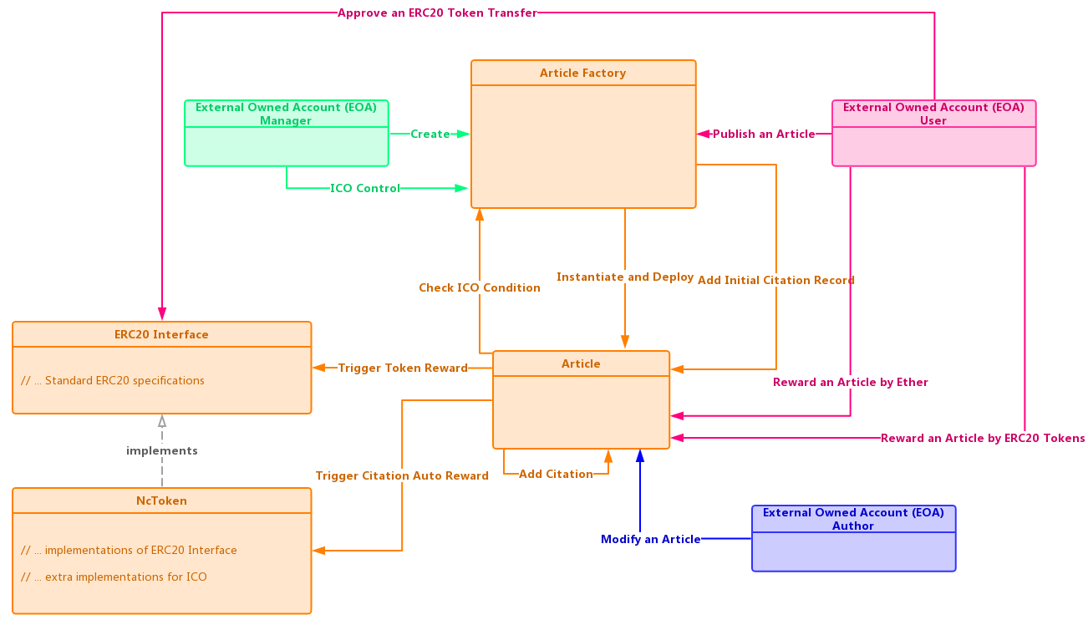
System Internals - Contract Design & Interaction

Slide 41
Exploring the source code

Slide 42
Live demo

Slide 43
Reflection and Discussion
Advantages
“dApp” - Take advantages of the P2P nature of Ethereum and Swarm
Fully decentralized
Fully traceable and transparent
Content permanently stored and available on Ethereum and Swarm
Limitations
Have to use Ethereum wallet (e.g. MetaMask) to send transactions
Low adoption rate, large education cost for traditional users
Future work
Serverless deployment of the server-side rendering logic for higher reliability and availability of the app
Server-side cache (Redis) to increase the content loading speed

Slide 44
Thank you
Q & A

